Slide 1
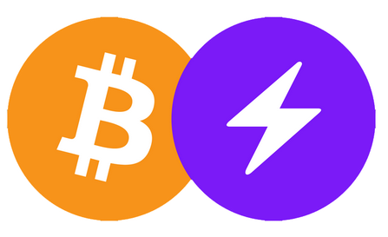

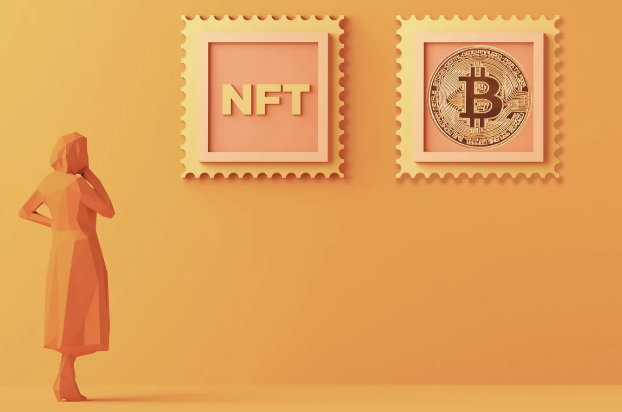
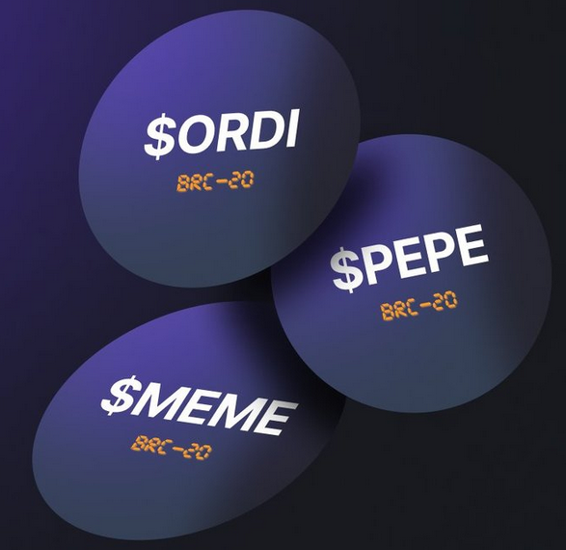
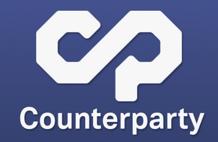
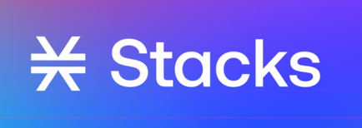
14. Bitcoin Sidechains & NFTs
BRC-20

Slide 2
Introduction to Sidechains (1/2)
https://www.coindesk.com/learn/an-introduction-to-sidechains/
“Enabling Blockchain Innovations with Pegged Sidechains,” Oct. 2014
A sidechain is a separate blockchain network that connects to another blockchain called a parent blockchain or mainnet – via a two-way peg.
These secondary blockchains have their own consensus protocols allowing a blockchain network to improve its privacy and security, and minimize the additional trust required to maintain a network.
A two-way peg allows digital assets such as bitcoin to be transferred back and forth between the mainnet and the new sidechain. Interestingly, the “transfer” of a digital asset never occurs. The assets are not actually transferred; instead, they are simply locked on the mainnet while the equivalent amount is unlocked in the sidechain.

Slide 3
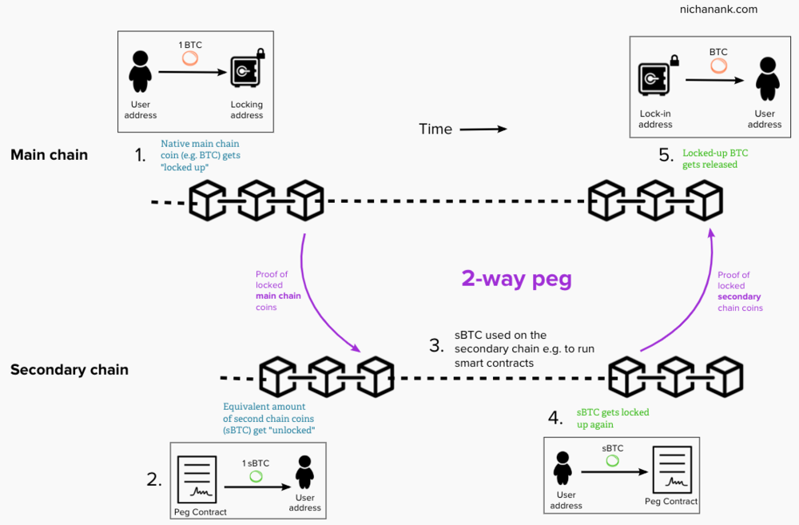
Introduction to Sidechains (2/2)
https://www.nichanank.com/blog/2018/8/26/sidechains-scalability-a-closer-look-at-rootstock-rsk

Slide 4
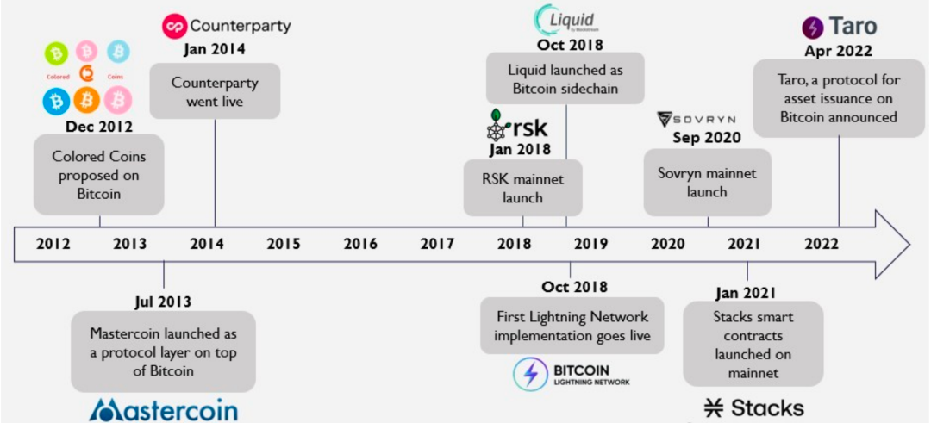
Major Events in Bitcoin Scaling & Programmability Development
以太坊超越比特幣，從絕無可能到近在咫尺？BRC20 又出來攪局 - 區塊客 (blockcast.it)

Slide 5

The Lightning Network (1/3)
https://medium.com/blockchain/the-lightning-network-explained
The Lightning Network (Layer 2 protocol) was designed to improve the speed and efficiency of transactions on the Bitcoin network by allowing users to make transactions off-chain without the need for block confirmation on the Bitcoin blockchain.
The Lightning Network allows users to create payment channels.
These channels can be thought of as a way for two users to make an unlimited number of transactions with each other without having to wait for block confirmation on the blockchain.
To create a payment channel, two users must deposit some bitcoin into a multi-signature wallet on the Lightning Network. This creates a “channel” between the two users, which can be used for any number of transactions.

Slide 6
The Lightning Network (2/3)
The two parties can transfer funds to each other indefinitely without informing the main blockchain. As all transactions on the layer-2 protocol do not need to be approved by all nodes, it substantially speeds up transactions.
Lightning Network nodes capable of routing transactions are formed by combining individual payment channels between the concerned parties. Therefore, the Lightning Network is the outcome of many payment channels being linked together.
Eventually, when the two parties decide to finish transacting, they can close the channel. All of the channel’s transactions are then consolidated into one transaction, which is sent to the Bitcoin mainnet to be recorded.
Fees are a combination of routing charges for routing payment information between Lightning nodes, opening and closing channels, and Bitcoin’s usual transaction fees.
For more details: https://www.horizen.io/academy/payment-channels/

Slide 7
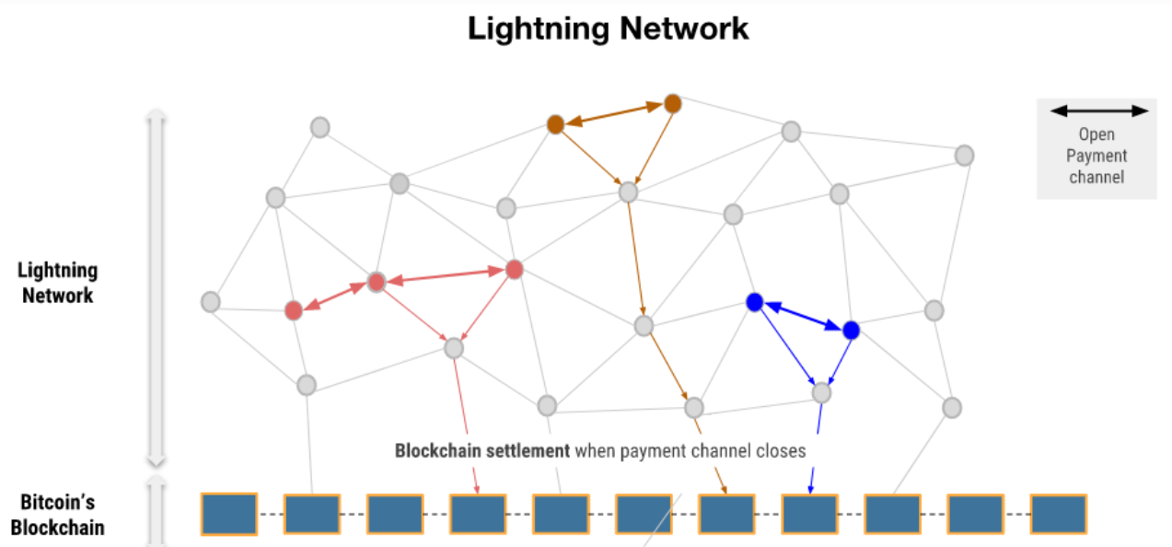
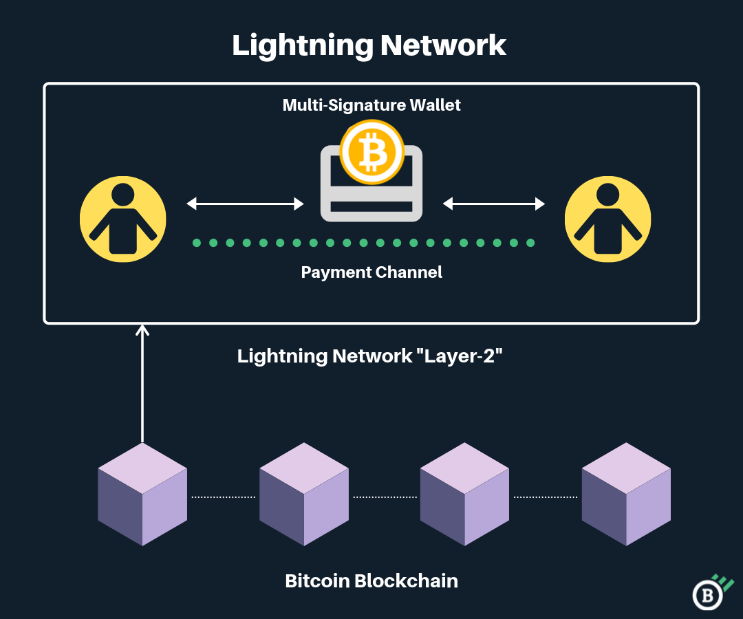
The Lightning Network (3/3)
https://zipmex.com/learn/what-is-lightning-network/
Lightning's fundamental technology is a local two-party consensus, known as a payment channel. Two parties send an initial amount of Bitcoin into a multi-signature transaction with a local consensus on the current balance allocated between the two participants.

Slide 8

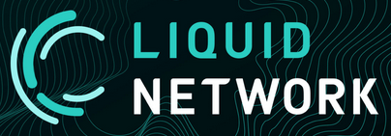
The Liquid Network (1/2)
https://trustmachines.co/learn/what-is-liquid-network/
Launched in 2018, Liquid Network (Layer-2 sidechain) operates independent of Bitcoin and has its own global ledger and consensus mechanism.
Instead of using an expensive proof-of-work consensus mechanism, Liquid created the Liquid Federation to serve as the creators of new blocks.
The Liquid Federation is a group of crypto-native organizations, including exchanges, trading desks, and developers, that perform vital tasks for the protocol.
Of the approximately 60 members, 15 act as functionaries for (1) confirming new blocks and (2) securing and managing Bitcoin funds held in the network’s multi-signature wallet.

Slide 9
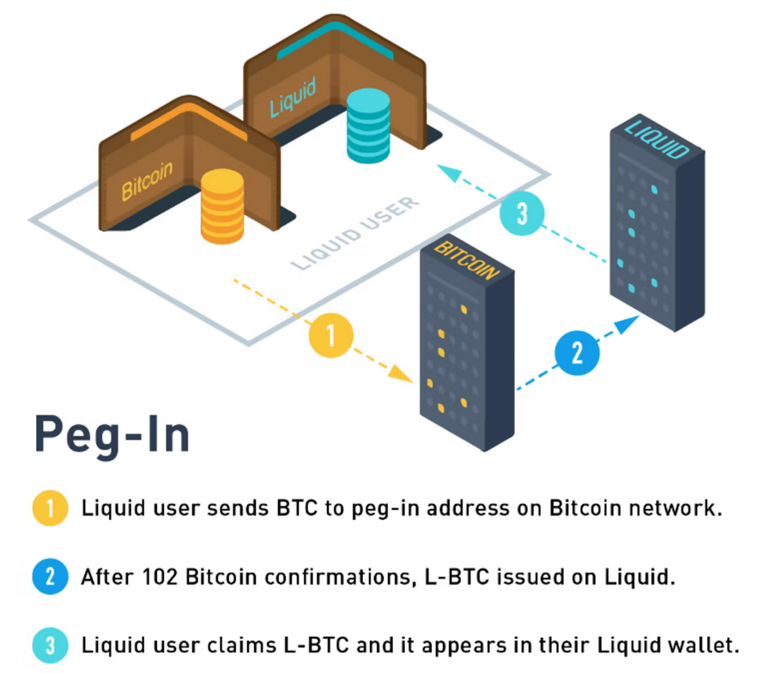
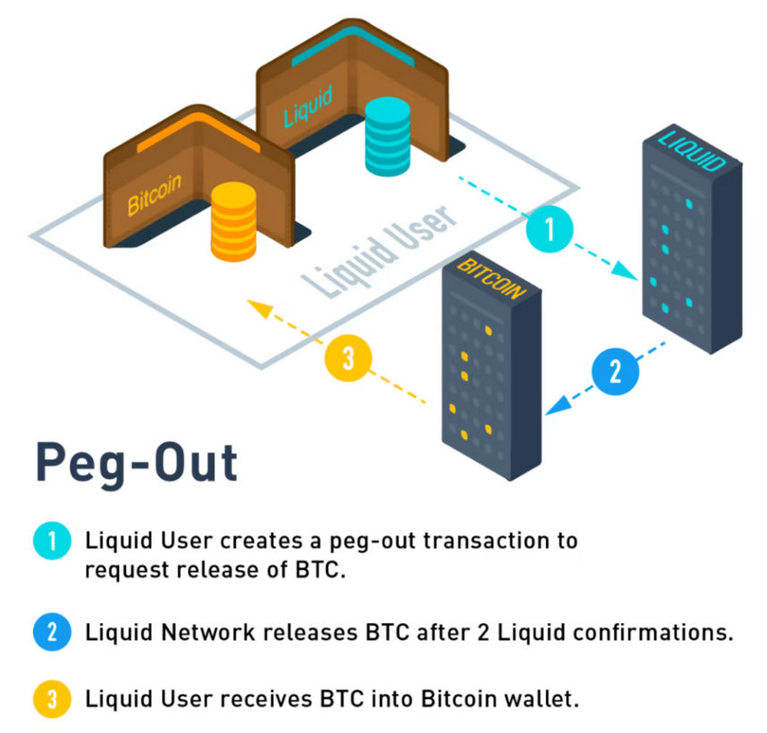
The Liquid Network (2/2)
Liquid Bitcoin (L-BTC) is a special type of asset on the Liquid sidechain. Its supply is verifiably backed 1-to-1 with bitcoin (BTC) held on the Bitcoin mainchain.
L-BTC is created when BTC is moved to the Liquid Network and destroyed when BTC is moved out of the network. The process of moving BTC to Liquid is known as a peg-in, and moving BTC out of Liquid is known as a peg-out.

Slide 10

Issued Assets on Liquid (1/2)
https://help.blockstream.com/hc/en-us/articles/900001543146
Anyone can issue their own tokens on Liquid. These tokens are known as Issued Assets. Issued Assets can be used for various applications, including stablecoins, security tokens, digital collectibles, reward points, and vouchers.
Unlike L-BTC, any obligations with regards to Issued Assets (e.g. redeemability) are the responsibility of the issuer. Although Liquid verifies and enforces the total number of units issued of each asset, users cannot verify the existence or maintenance of any underlying assets.

Slide 11
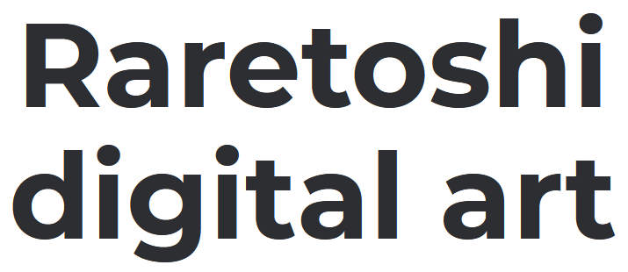
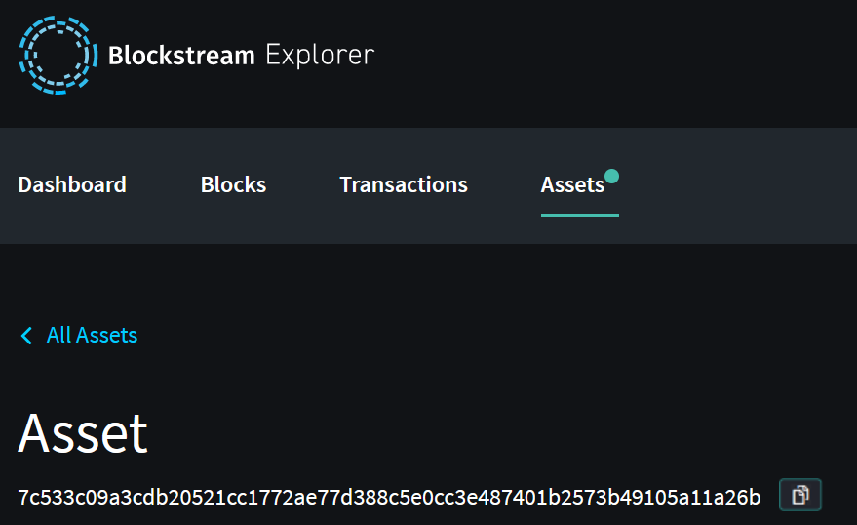
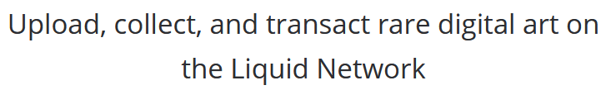
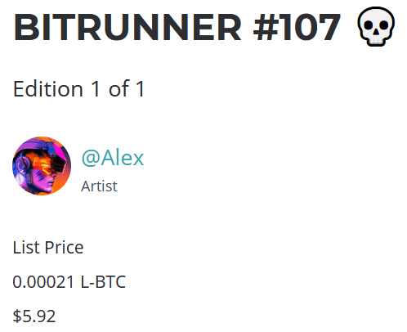
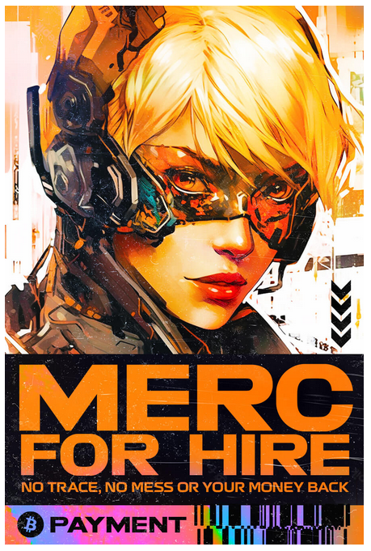
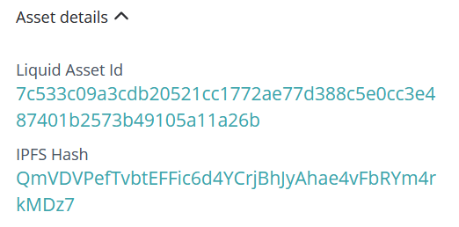
Issued Assets on Liquid (2/2)
https://raretoshi.com/
https://blockstream.info/liquid/asset/7c533c09a3cdb20521cc1772ae77d388c5e0cc3e487401b2573b49105a11a26b

Slide 12
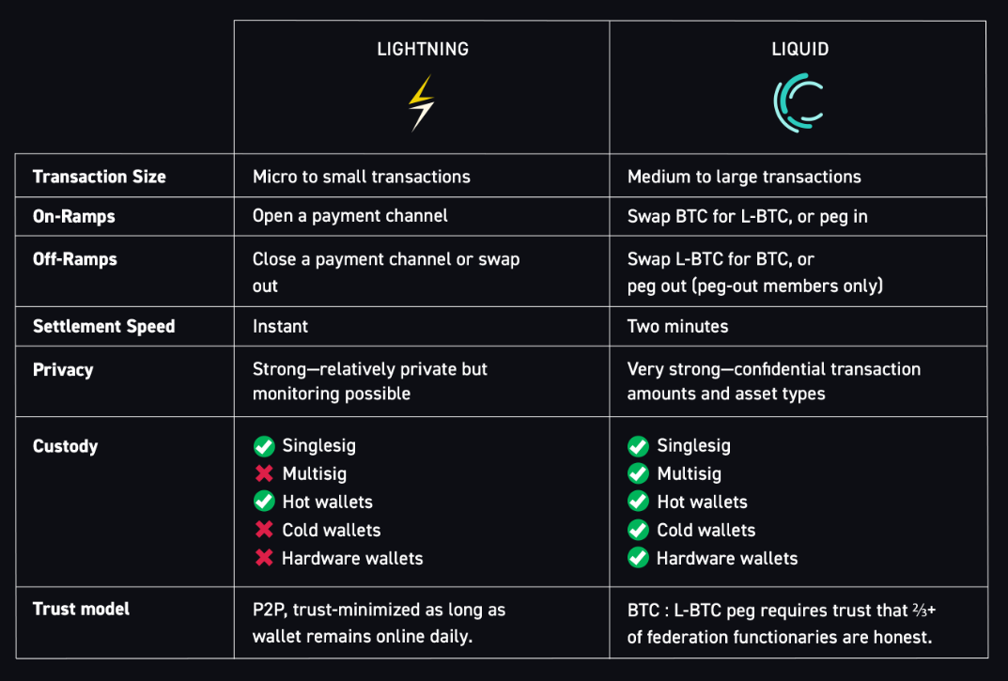
Lightning Network vs. Liquid Network
https://blog.liquid.net/six-differences-between-liquid-and-lightning/

Slide 13
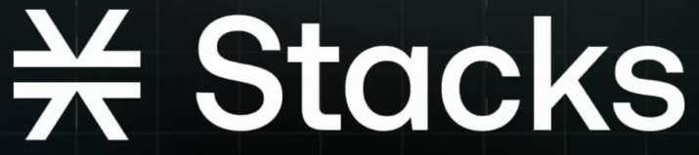
STACKS Network (1/3)
https://trustmachines.co/learn/what-is-stacks/
Stacks is an open-source Layer 2 blockchain that introduces smart contracts and decentralized applications to Bitcoin.
Stacks’ groundwork began as early as 2013. The Stacks testnet was eventually launched in Q2 of 2018, with its mainnet released a few months later in October 2018.
Stacks network builds on the Bitcoin blockchain through its consensus mechanism, Proof-of-Transfer (PoX).
Proof-of-Transfer is a variation of Proof-of-Burn (PoB), which grants Stacks miners the right to mine blocks by “burning” a portion of their tokens (either a native asset or another cryptocurrency). By burning, Stacks miners can mine more blocks, earning BTC rewards for helping secure the network.

Slide 14
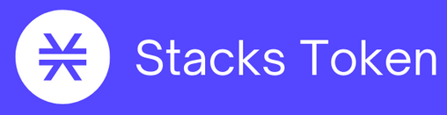
STACKS Network (2/3)
With Stacks, Proof-of-Transfer requires miners to send BTC (on the Bitcoin network) to other Stacks network participants, rather than a burn address. Since Stacks can read the Bitcoin network state, it can then verify the occurrence of these Bitcoin transactions.
Active miners must commit an equal amount of bitcoin to two Stackers' addresses for every block. These addresses are chosen randomly using a verifiable random function (VRF). The miners' minimum recommended commitment is 11,000 satoshis (0.00011 BTC), or 5,500 satoshis per Stacker address.
The Stacks protocol then randomly selects a winning miner for that block and rewards them with Stacks’ native token, STX.

Slide 15
STACKS Network (3/3)
Stacks interacts with Bitcoin without modifying its base layer’s protocol whatsoever. Bitcoin ultimately serves as the final settlement layer for Stacks, as Stacks transactions are bundled and then sent to be verified and validated on Bitcoin. Subsequently, the history of every Stacks block is forever recorded on the Bitcoin blockchain.
Stacking on Stacks
Similar to staking on Proof-of-Stake blockchains, stacking is a reward system that distributes native Bitcoin (BTC) to users for supporting the network and locking away STX tokens for a period of time.
Stacking is funded through the Bitcoin transactions that Stacks miners execute to participate in securing the Stacks blockchain.

Slide 16
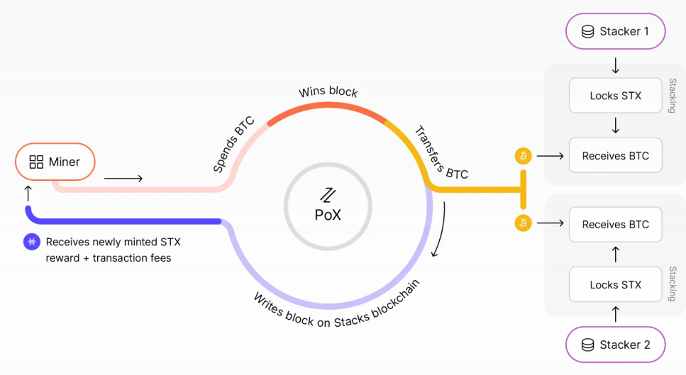
Proof-of-Transfer (PoX)

Slide 17
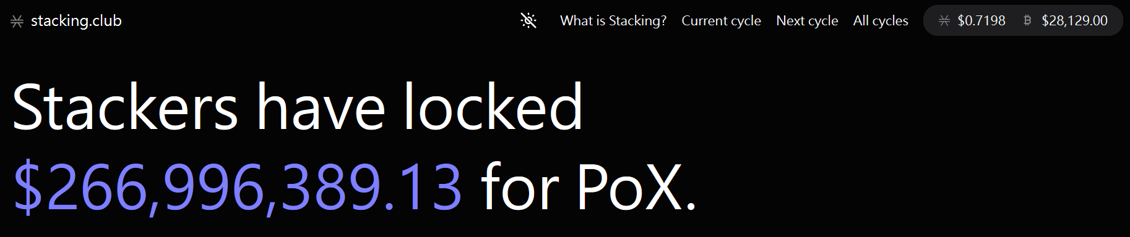
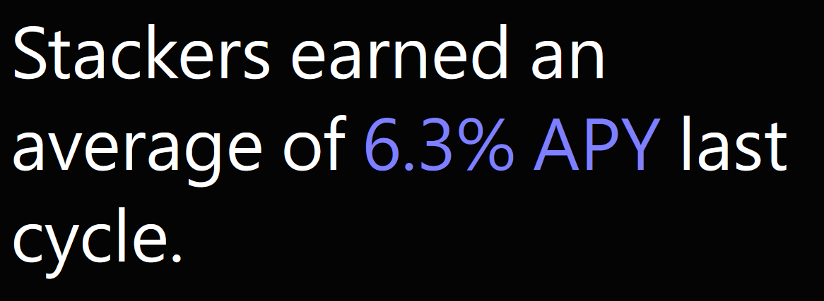
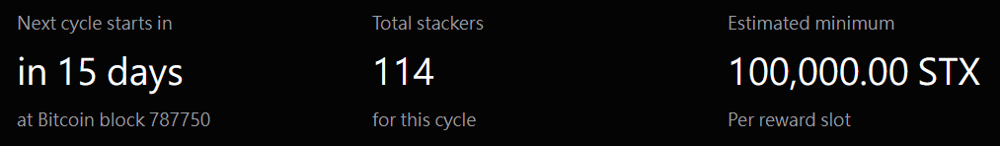
Stacking on Stacks
https://stacking.club/
As of 2023.4.21

Slide 18
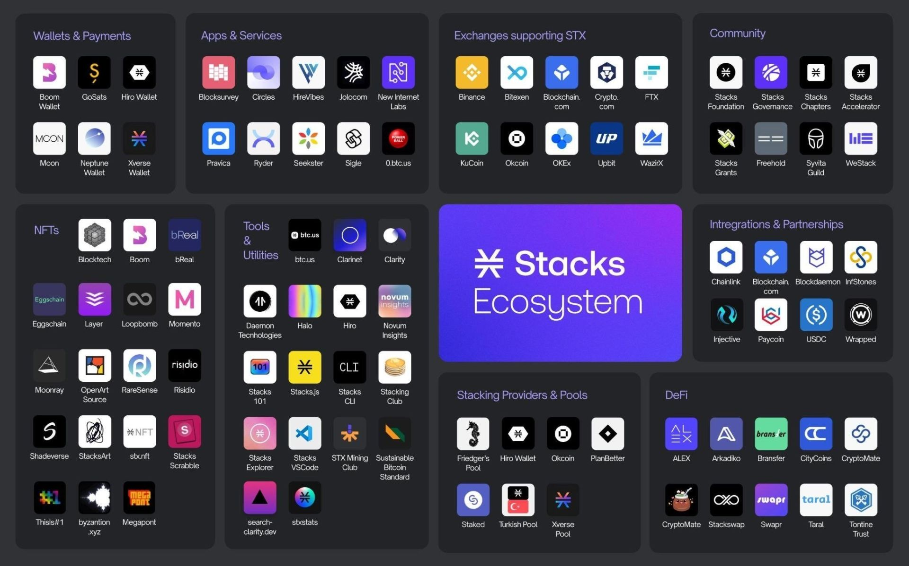

Slide 19
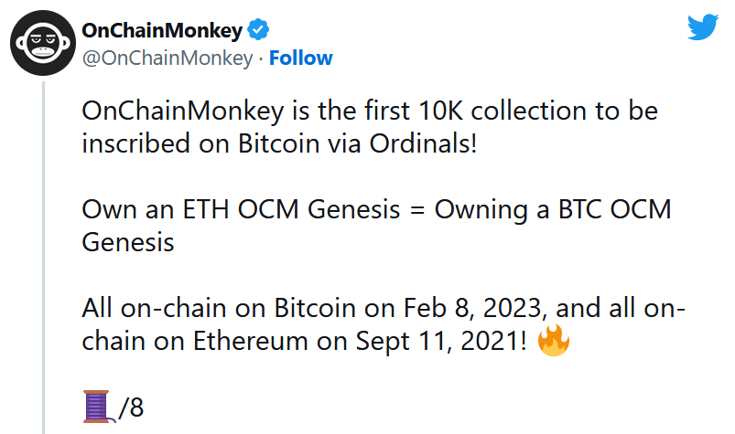
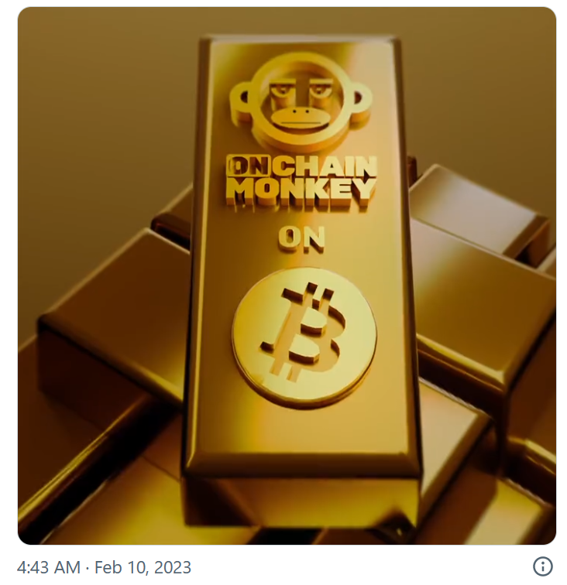
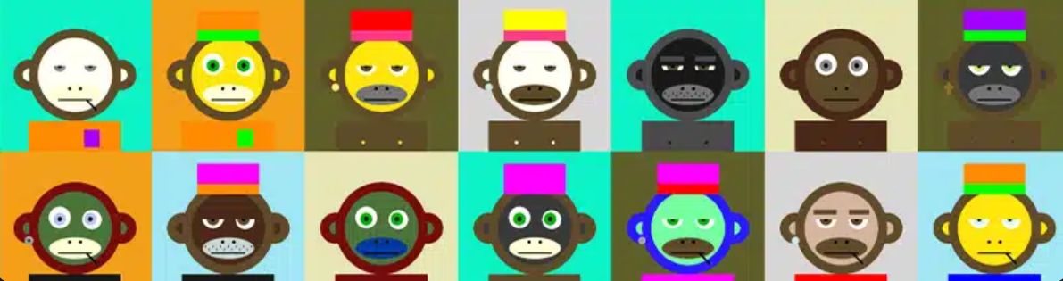
Bitcoin On-Chain NFTs (1/2)
https://twitter.com/i/status/1623784604309278720

Slide 20
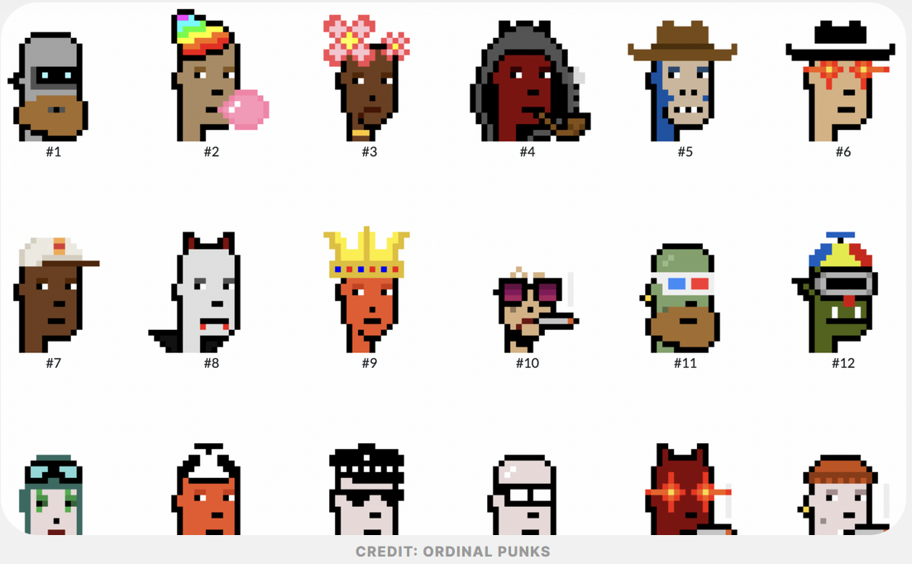
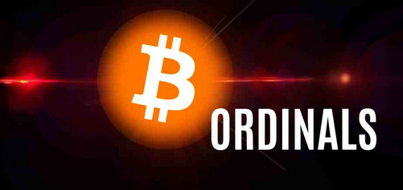
Bitcoin On-Chain NFTs (2/2)
OP_Return Wars of 2014 & Counterparty protocol
Ordinals & Inscriptions

Slide 21
The OP_Return Wars of 2014 (1/5)
https://blog.bitmex.com/dapps-or-only-bitcoin-transactions-the-2014-debate/
Debate about whether and how a DApp protocol called Counterparty should use Bitcoin’s blockchain.
Counterparty launched towards the start of 2014. Counterparty is a protocol layer on top of Bitcoin that enables features such as new token creation and the trading of these tokens on a distributed exchange.
The system works by using parts of Bitcoin transaction data and using this in the Counterparty protocol, as a function, such as creating a token, sending a token or a market bid on a token on a distributed exchange.
At the start Counterparty used the Bitcoin opcode OP_CHECKMULTISIG to include Counterparty related data into the Bitcoin blockchain. This opcode was supposed to be used to verify the signature for a pay to script hash (P2SH) multi signature transaction.

Slide 22
The OP_Return Wars of 2014 (2/5)
Using OP_CHECKMULTISIG can be thought of as a hack, because this was not the intended use of the opcode. Counterparty now uses Bitcoin’s OP_Return opcode to store data, which is more inline with what developers intended, to some extent.
OP_Return
OP_Return is a transaction output in Bitcoin that is provably unspendable.
The function can be used to burn Bitcoin or store arbitrary data in the Bitcoin blockchain. Since the data is not part of the UTXO set, storing data this way is said to help scale Bitcoin, as nodes that engage in pruning do not need to store OP_Return data.
In March 2014, Bitcoin Core 0.9.0 was released with the OP_Return feature included as a standard transaction type, therefore the transactions would be relayed by default.

Slide 23
The OP_Return Wars of 2014 (3/5)
Debate about the Bitcoin developers planning to limit OP_Return to just 40 bytes rather than 80 bytes.
On 20th March 2014, one of Bitcoin’s main contributors at the time, Jeff Garzik, was criticizing the use of blockchain space by Counterparty.
“To date, I’ve not seen a blockchain data dumping scheme that could not be securely replaced with a simple hash. You don’t need to store data in the blockchain. That is purely intellectual laziness. Timestamping hash (data) is just as secure, while more efficient. Furthermore, a secondary chain can be provably pegged to bitcoin.”
On 25th March 2014, Vitalik Buterin said:
“It’s the protocol’s fault the OPRETURN battle is such an issue. In an ideal world, the concept of ‘abuse’ would not even exist; fees would be mandatory, and carefully structured to closely match the actual cost that a given transaction imposes on the network. If you can pay the fees for what you’re doing then you should be able to do it, no questions asked.”

Slide 24
The OP_Return Wars of 2014 (4/5)
PhantomPhreak, a Counterparty co-founder said:
“First of all, Counterparty transactions are financial transactions. Second, every full node has consented to download and store the Bitcoin blockchain, no less. That is, transactions that accord to the Bitcoin protocol, which Counterparty transactions obviously do.”
“Bitcoin does lots of things that it was not originally intended to do. Yes, we’d greatly prefer to use a more elegant solution than what we have now. Counterparty was originally designed to use the OP_RETURN output to store all of its message data, which I feel is very elegant, and leaves a minimal impact on the blockchain. We planned all of our message formats around the 80 byte limit announced by Gavin on the official Bitcoin blog. We only use multi-sig outputs because we have no other choice. We don’t want to extend the Bitcoin protocol. We want to do something entirely within it, and as simply and directly as possible, for the benefits to stability, security etc.”

Slide 25
The OP_Return Wars of 2014 (5/5)
Some developers left Bitcoin as a result of this and instead built their protocols on other blockchain systems such as Ethereum.
After around 2014, most developers interested in DApps focused on building on Ethereum or other systems, not on Bitcoin. Ethereum then achieved a critical mass of developer interest and momentum, and DApp development on Bitcoin was minimal.
In 2016, Bitcoin Core 0.11.1 finally increased the relay limit to 80 bytes, the limit we have today.
This means that if one wants a transaction with an OP_Return output of over 80 bytes today, one has to mine it themselves or send it directly to a miner. (Bitcoin’s consensus rules allow an OP_Return size of up to 10,000 bytes.)
https://bitcoin.stackexchange.com/questions/117594/what-are-bitcoins-transaction-and-script-limits
Notes:
P2SH scripts have a size limit of 10k bytes by consensus. Standardness rules only allow for 520 bytes for the redeem script though, which is enough for a 15-of-15 multisig. The maximum unlocking script (scriptSig) size is 1650 bytes.
The consensus rules have no limit to an OP_RETURN size, i.e. the size of the transaction is the limit. One can also have more than one OP_RETURN in a transaction. However, standardness rules specify that only one OP_RETURN output is allowed per transaction with a maximum data size of 80 bytes. (看不懂)

Slide 26
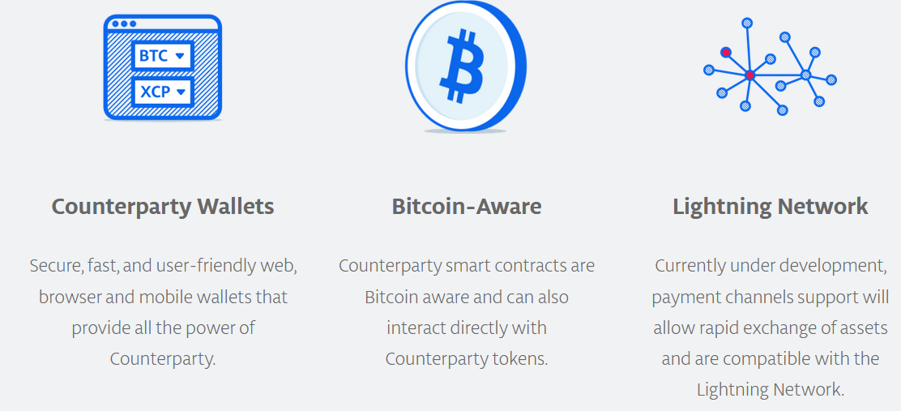
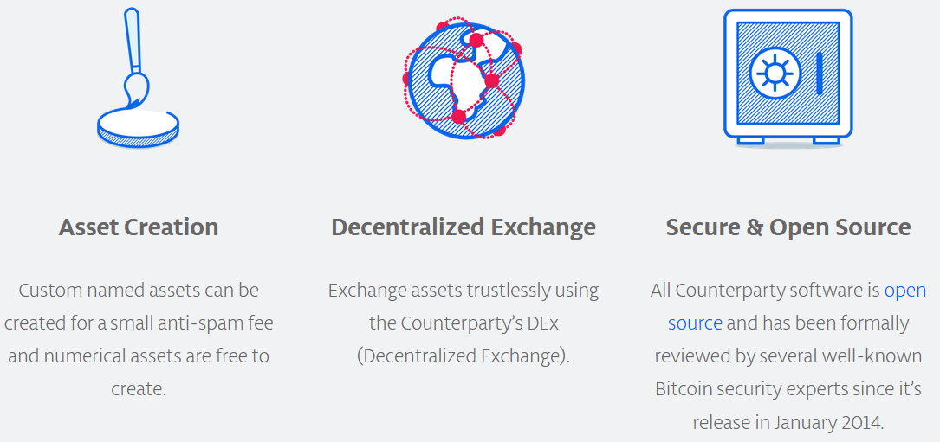
Introduction to Counterparty
https://coinmarketcap.com/currencies/counterparty/
https://counterparty.io/

Slide 27
Bitcoin Ordinal Theory (1/3)
https://docs.ordinals.com/overview.html
Ordinals are a numbering scheme for satoshis (sats) that allows tracking and transferring individual satoshis. These numbers are called ordinal numbers.
Satoshis are the smallest unit of Bitcoin with a value of 0.00000001 BTC.
Satoshis are numbered in the order in which they're mined, and transferred from transaction inputs to transaction outputs first-in-first-out.
Both the numbering scheme and the transfer scheme rely on order, the numbering scheme on the order in which satoshis are mined, and the transfer scheme on the order of transaction inputs and outputs. Thus the name, ordinals.
Ordinal theory does not require a separate token, another blockchain, or any changes to Bitcoin. It works right now.

Slide 28
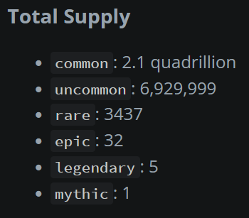
Bitcoin Ordinal Theory (2/3)
Rarity
Humans are collectors, and since satoshis can now be tracked and transferred, people will naturally want to collect them. Ordinal theorists can decide for themselves which sats are rare and desirable.
Rarity levels:
common: Any sat that is not the first sat of its block
uncommon: The first sat of each block
rare: The first sat of each difficulty adjustment period
epic: The first sat of each halving epoch
legendary: The first sat of each cycle
mythic: The first sat of the genesis block

Slide 29
Bitcoin Ordinal Theory (3/3)
https://docs.ordinals.com/faq.html
Ordinal theory is a protocol for assigning serial numbers to satoshis, and tracking those satoshis as they are spent by transactions.
Ordinal numbers are assigned to satoshis in the order in which they are mined. The first satoshi in the first block has ordinal number 0, the second has ordinal number 1, and the last satoshi of the first block has ordinal number 4,999,999,999.
Satoshis live in outputs, but transactions destroy outputs and create new ones, so ordinal theory uses an algorithm to determine how satoshis hop from the inputs of a transaction to its outputs.
Satoshis transfer in first-in-first-out order. Think of the inputs to a transaction as being a list of satoshis, and the outputs as a list of slots, waiting to receive a satoshi. To assign input satoshis to slots, go through each satoshi in the inputs in order, and assign each to the first available slot in the outputs.

Slide 30
Bitcoin Inscriptions (1/2)
https://docs.ordinals.com/inscriptions.html
Inscriptions inscribe sats with arbitrary content, creating bitcoin-native digital artifacts, more commonly known as NFTs.
Inscriptions do not require a sidechain or separate token.
These inscribed sats can then be transferred using bitcoin transactions, sent to bitcoin addresses, and held in bitcoin UTXOs. These transactions, addresses, and UTXOs are normal bitcoin transactions, addresses, and UTXOs in all respects, with the exception that in order to send individual sats, transactions must control the order and value of inputs and outputs according to ordinal theory.
An inscription consists of a content type, also known as a MIME type, and the content itself, which is a byte string. This allows inscription content to be returned from a web server, and for creating HTML inscriptions that use and remix the content of other inscriptions.

Slide 31
Bitcoin Inscriptions (2/2)
Inscription content is stored in taproot script-path spend scripts.
Taproot upgrade (a soft fork) was activated in November 2021.
Since taproot script spends can only be made from existing taproot outputs, inscriptions are made using a two-phase commit/reveal procedure.
First, in the commit transaction, a taproot output committing to a script containing the inscription content is created.
Second, in the reveal transaction, the output created by the commit transaction is spent, revealing the inscription content on-chain.
Inscription content is serialized using data pushes within unexecuted conditionals, called "envelopes".
Envelopes consist of an OP_FALSE OP_IF … OP_ENDIF wrapping any number of data pushes. Because envelopes are effectively no-ops, they do not change the semantics of the script in which they are included, and can be combined with any other locking script.

Slide 32
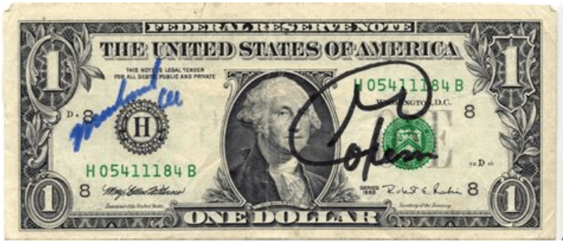
Analogy of Bitcoin Inscriptions
Imagine two one-dollar bills.
Both are completely fungible but have a serial code, which allows us to identify each dollar bill as unique. But if one bill was signed by Muhammed Ali and George Foreman, it becomes a "dollar NFT" of sorts. You could still spend it as a regular dollar, but the signatures make the bill's value skyrocket.
https://coinmarketcap.com/alexandria/article/what-are-bitcoin-ordinals-the-ultimate-guide-to-bitcoin-nfts

Slide 33
Ref. More About Bitcoin Inscriptions
https://blog.coinshares.com/ordinals-and-inscriptions-primer-849deb3a638
Interestingly, once a file is inscribed to a satoshi on the Bitcoin blockchain, it is a part of the history of that satoshi forever. The inscription itself cannot be modified or deleted. The owner of an inscribed satoshi has only three options: (1) hold, (2) add an additional inscription to the satoshi such that it is associated with 2 files, or (3) transfer the inscribed satoshi to someone else (note: this option would not require re-attaching the same file data to the satoshi).

Slide 34
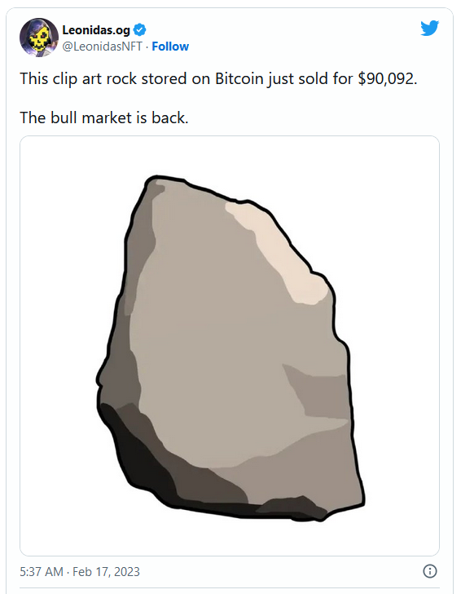
Q. Do you know which UTXO fees are chosen from?
I have a UTXO with an inscription that is now valuable, but I accidentally received it into a non-Taproot (bech32, native segwit) wallet.
I'm now aware that because of this, I can't use Ordinal theory to control which satoshis are being spent when I send this transaction.
What I'm wondering is, is there any way to dictate which UTXO the fees come from? This was accepted into a clean wallet, so it's currently the only UTXO. If I add another UTXO, would the fees come from that instead? Thus ensuring that the first UTXO is fully received by the receiver.
https://bitcoin.stackexchange.com/questions/117092/do-know-which-utxo-fees-are-chosen-from-need-help-on-an-inscription-in-a-native

Slide 35
BRC-20
What Are BRC-20 Tokens? Explaining the Bitcoin Memecoin Hype | CoinMarketCap
BRC-20 tokens build upon the concept of marking single satoshis, as seen in Bitcoin Ordinals. While Ordinals tag individual satoshis to serve as NFTs, BRC-20 tokens involve "minting" satoshis so they hold information about a whole collection of tokens.
For example, if you wanted to create a collection of 100 hypothetical $RANDO BRC-20 tokens, you'd mint the collection by inscribing one sat with the relevant JSON data. JSON data can be used to define the token name, symbol, supply and other properties. Users can also use JSON data to mint new tokens or transfer existing tokens to other addresses.
Or to use the dollar/sats metaphor again: you mark one dollar bill with information about 20 $RANDO stickers, which are not dollar bills. You always need a dollar bill to transfer stickers. But the bill does not back the stickers themselves, nor can they do anything.

Slide 36
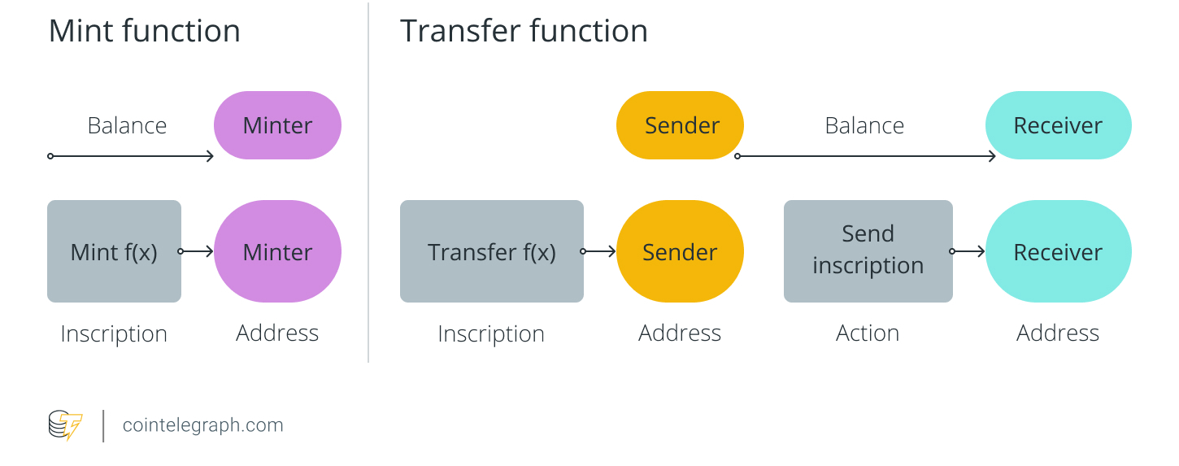
Mint & Transfer function of BRC-20 Tokens
https://cointelegraph.com/learn/what-is-a-brc-20-token-standard-an-overview

Slide 37
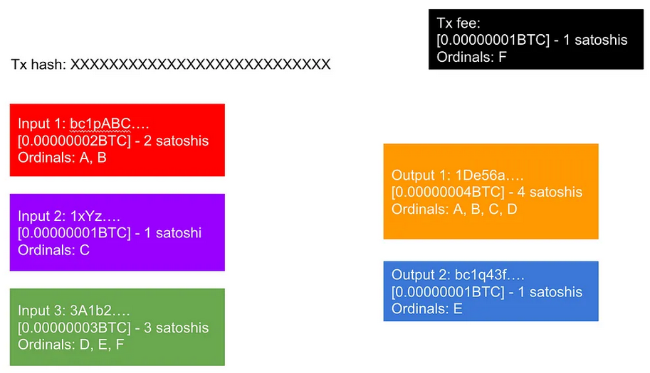
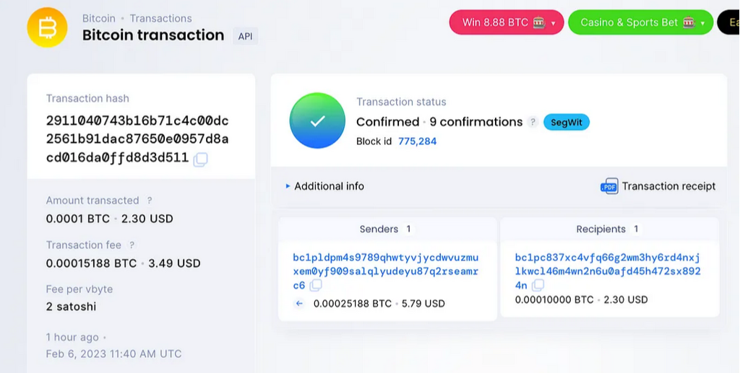
Further Readings (1/2)
A Comprehensive Explanation of Ordinals: NFTs on Bitcoin

Slide 38
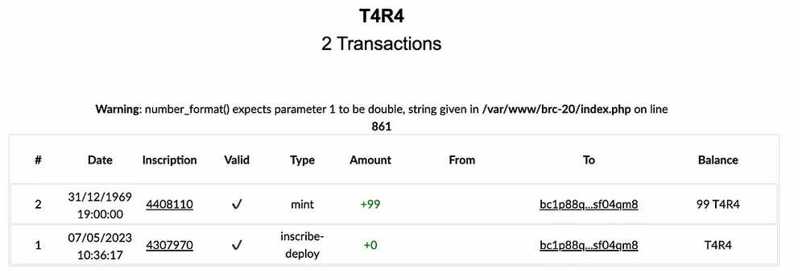
Further Readings (2/2)
Explaining BRC20: The New Standard for Fungible Tokens on Bitcoin
1. Deploy your BRC20 token
2. Mint your BRC20 token
3. Transfer your BRC20 token

